Slide 1
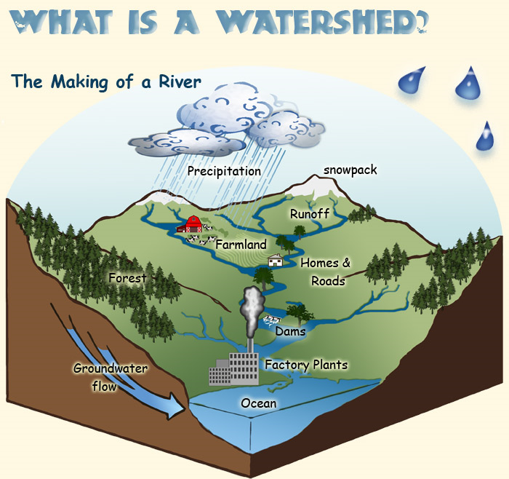
Where's our water?
By Zach,
Toby

Slide 2
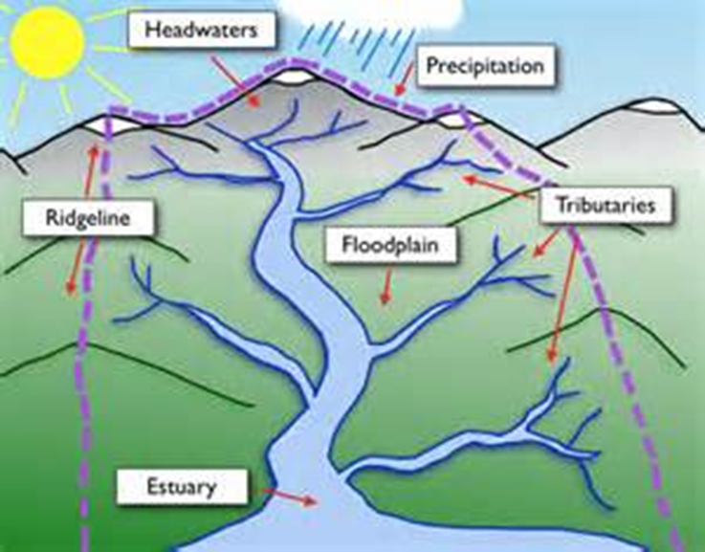
What is a watershed?
A watershed is the land that water moves across or under while flowing to a stream, spring, pond, lake or a river.

Slide 3
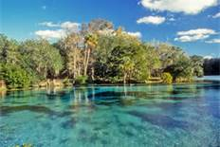
A watershed is very in size from the largest river basins to just acres or less in size.

Slide 4
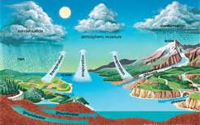
We all live in a water shed. Some people live in different watersheds than others

Slide 5
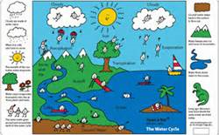
Some people live in the Bryant Creek Watershed, Beaver Creek watershed , and Fox Creek wateshed. Other people might live in a different watershed.

Slide 6
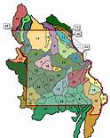
There are watersheds all around the world. There are 45 watersheds in Missouri, but there are 4 main ones.

Slide 7
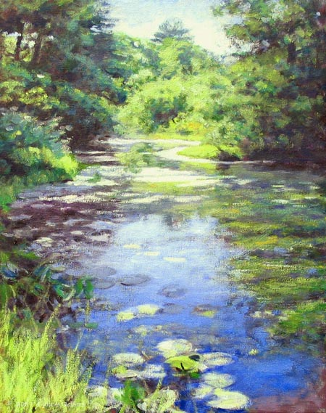
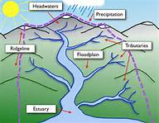
A tributary is a stream that flows to a larger stream or other body of water.

Slide 8
Keeping Our Water Clean
We need to keep our water in our watershed clean, because it can harm our bodies, an even our animals, if we
drink it.

Slide 9
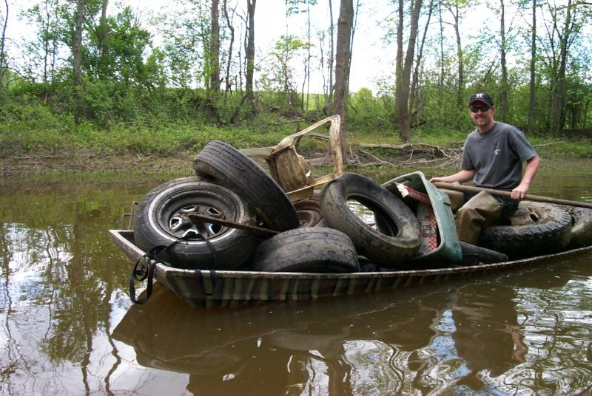
So we need to keep the pollution out of our creeks and streams to keep them clean. We can keep them clean by picking up trash out of the river.

Slide 10
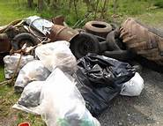
We can keep our watershed clean if we all work together by picking up trash that is in our watershed and throwing it away.

Slide 11
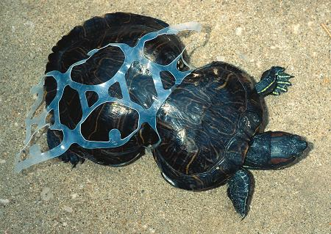
We also need to clean the trash off the banks to. So that when the wind blows or when it rains will not be carried into the river and hurt the animals in the river.

Slide 12
CREDITS
http://www.fs.fed.us/rm/boise/research/techtrans/projects/scienceforkids/watersheds.shtml
http://cserc.org/main/games/water/LabeledWatershed.png
http://floridatraveler.com/wpcontent/uploads/silverglen.jpg
http://kids.britannica.com/comptons/art-53235/The-Earths-water-is-constantly-recycled

Slide 13
http://cserc.org/main/games/water/index.htm
http://leonidas75.edu.glogster.com/5-the-water-cycle
http://floridatraveler.com/silver-glen-springs/

Slide 14
http://forums.gearboxsoftware.com/showthread.php?p=2684159
http://www.cis.stclaircounty.org/streamclean.asp
http://www.funnywallphotos.com/im-sick/
http://www.muchbetteradventures.com/news/view/388/peanut-turtle-deformed-by-our-rubbish
http://lynneadamsart.com/images/Tributary.jpg

